Slide 1

Common Chart Types and Use Cases
Tree Maps
Sunburst Charts
Waterfall & Funnel Charts
Radar Charts

Slide 2
The Practice Excel File
In this section, open the “Excel-Part 4.xlsx” file and generate plots for each sheet.

Slide 3
Treemap Charts
Used for: Visualizing hierarchical part-to-whole relationships with proportional areas.
Examples:
Corporate organizational structures
Product category sales breakdowns
Pro Tips:
Limit categories to 8-10 for clarity (nested hierarchies can show more).
Use vivid color gradients to represent quantitative variables like growth or performance.
Label strategically - prioritize top-level categories and use interactive tooltips for details.

Slide 4
When to choose over pie/donut:
Comparing multiple hierarchy levels simultaneously
Showing proportions WITH associated size metrics (e.g., revenue + profit margin)
Displaying "nested" relationships (e.g., regions → countries → cities)

Slide 5
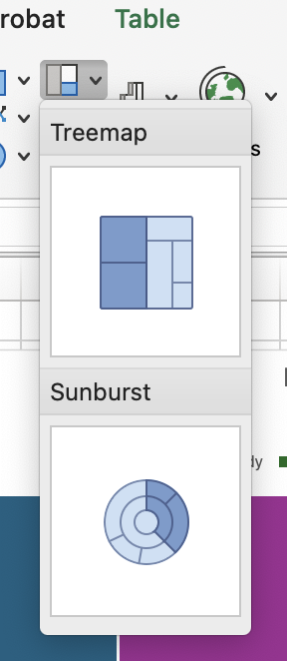
Practice: Treemap Charts
Sheet name on the Excel file: Treemap Charts
Select the Entire Table
Go to the Insert tab and select Treemap.
Design the Chart as needed.

Slide 6
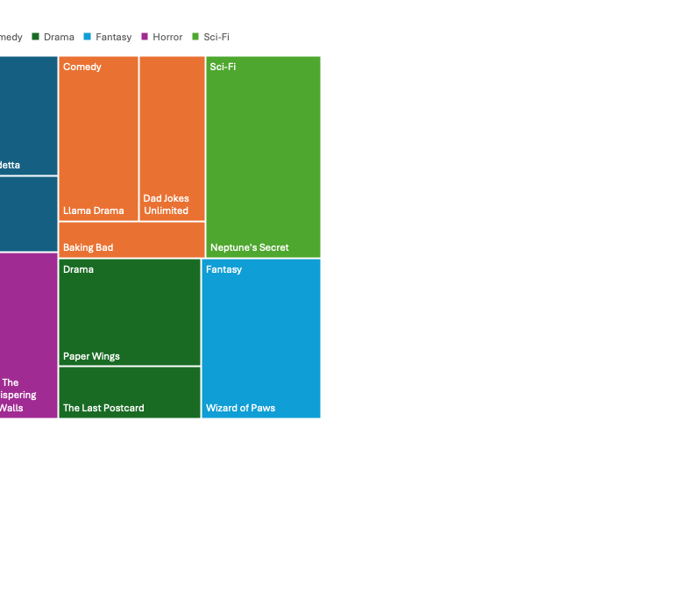
Practice: Movie Data

Slide 7
Sunburst Charts
Used for: Displaying hierarchical part-to-whole relationships across multiple levels.
Examples:
Budget allocation (Department → Team → Project)
File system storage (Drive → Folder → File Type)
E-commerce sales (Category → Subcategory → Product)
Pro Tips:
Limit depth to 3–4 rings to avoid visual clutter.
Prioritize order—place most important segments at the inner rings

Slide 8
Practice: Treemap Charts
Sheet name on the Excel file: Sunburst Charts
Select the Entire Table
Go to the Insert tab and select Sunburst.
Design the Chart as needed.

Slide 9
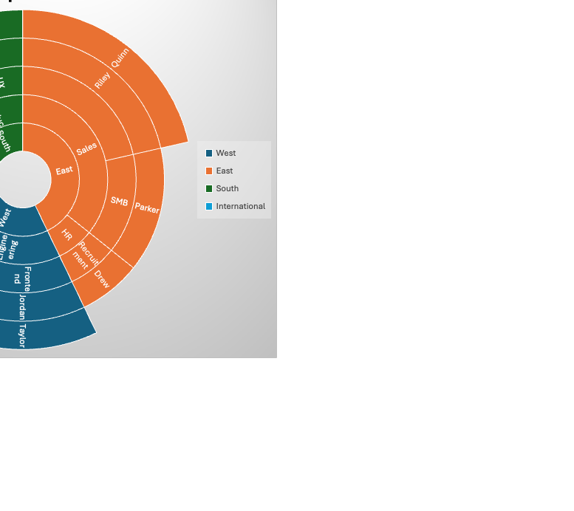
Practice: Corporate Structure

Slide 10
Waterfall Charts
Used for: Sequential positive/negative contributions to a final total (e.g., profit drivers, inventory changes).
Key Components:
Starting value (e.g., initial revenue)
Increases/Decreases
Final value (e.g., net profit)

Slide 11
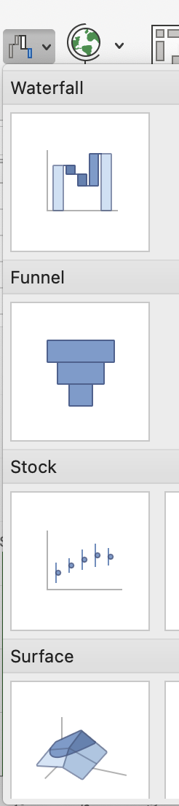
Practice: Waterfall Charts
Sheet name on the Excel file: Waterfall Charts
Select the Entire Table
Go to the Insert tab and select Waterfall.
Design the Chart as needed.
Right click on the total data columns on the graph and select “Set as Total”

Slide 12
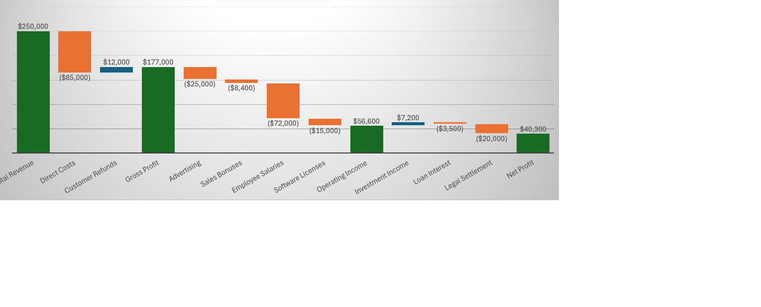
Practice: Company Profit Analysis

Slide 13
Funnel Charts: The Ultimate Leak-Detector
Used for:
Tracking attrition in multi-stage processes
Identifying bottlenecks in user journeys
Comparing conversion rates across campaigns
Examples:
• E-commerce: "Why 90% of carts get abandoned" • Healthcare: "Patient screening to treatment adherence" • HR: "Job applications → hires pipeline"

Slide 14
Practice: Waterfall Charts
Sheet name on the Excel file: Funnel Charts
Select the Entire Table
Go to the Insert tab and select Waterfall.
Design the Chart as needed.

Slide 15
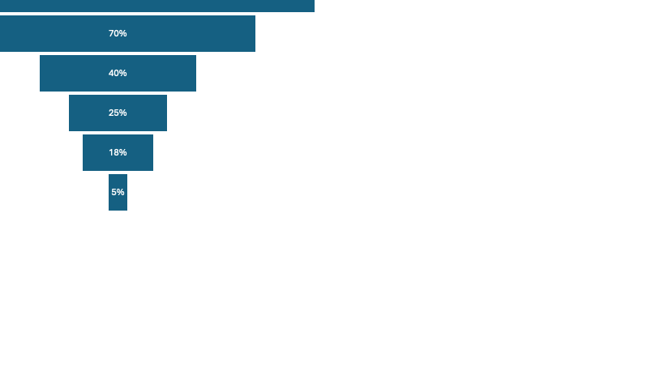
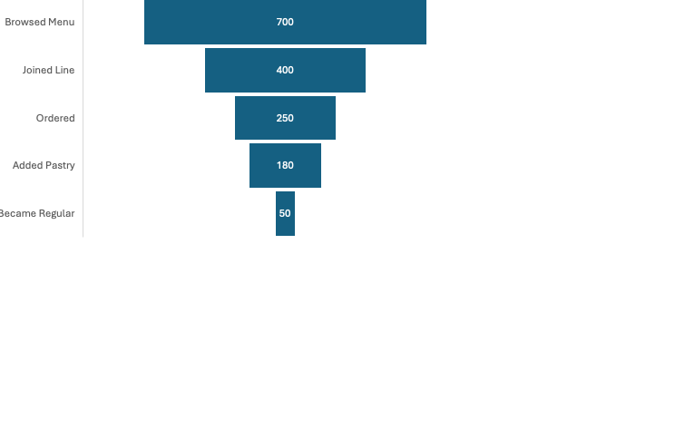
Practice: A Coffee Shop Case Study
Problem: A coffee shop gets 1,000 daily visitors but only 120 buy. Where do we lose them?
Key Insight: The biggest drop happens at "Browsed Menu → Joined Line" – Are lines too long? Menu confusing?

Slide 16
Radar Charts: A Visual Tool for Multivariate Comparison
What is a Radar Chart?
Displays 3+ quantitative variables on axes from the same central point.
Useful for visualizing performance or comparison.
When to Use Radar Charts
Comparing items (e.g., foods, players) on many dimensions.
Better than bar charts when variables are numerous.
Visual appeal makes interpretation intuitive for general audiences.

Slide 17
Radar Charts: Smartphone Comparison
Scenario:
A tech reviewer wants to compare 2 smartphones across 6 key features.
Variables: Battery Life, Camera Quality, Performance, Design, Price, Storage

Slide 18
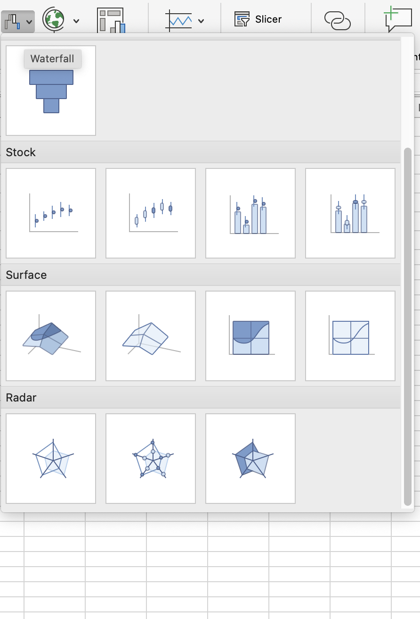
Practice: Radar Charts
Sheet name on the Excel file: Radar Charts
Select the Entire Table
Go to the Insert tab and select Radar.
Design the Chart as needed.

Slide 19
Radar Charts: Smartphone Comparison

